Slide 1
Bank-as-a-Service(Baas) Risk Monitoring
Delphin | Solomon | Tycho
The Catholic University of America
Capstone Project
Fall 2025

Slide 2
Introduction (Problem Domain)
Growth of digital transactions in BaaS, increases exposure to fraud.
Fraudulent activities cause financial losses, reputational damage, and loss of customer trust.(Synapse collapse in 2024).
BaaS platforms need real-time monitoring to serve Fintech partners.
Current systems struggle with accuracy, with high False positive (legitimate flagged) and high False Negative(Fraud Missed).

Slide 3
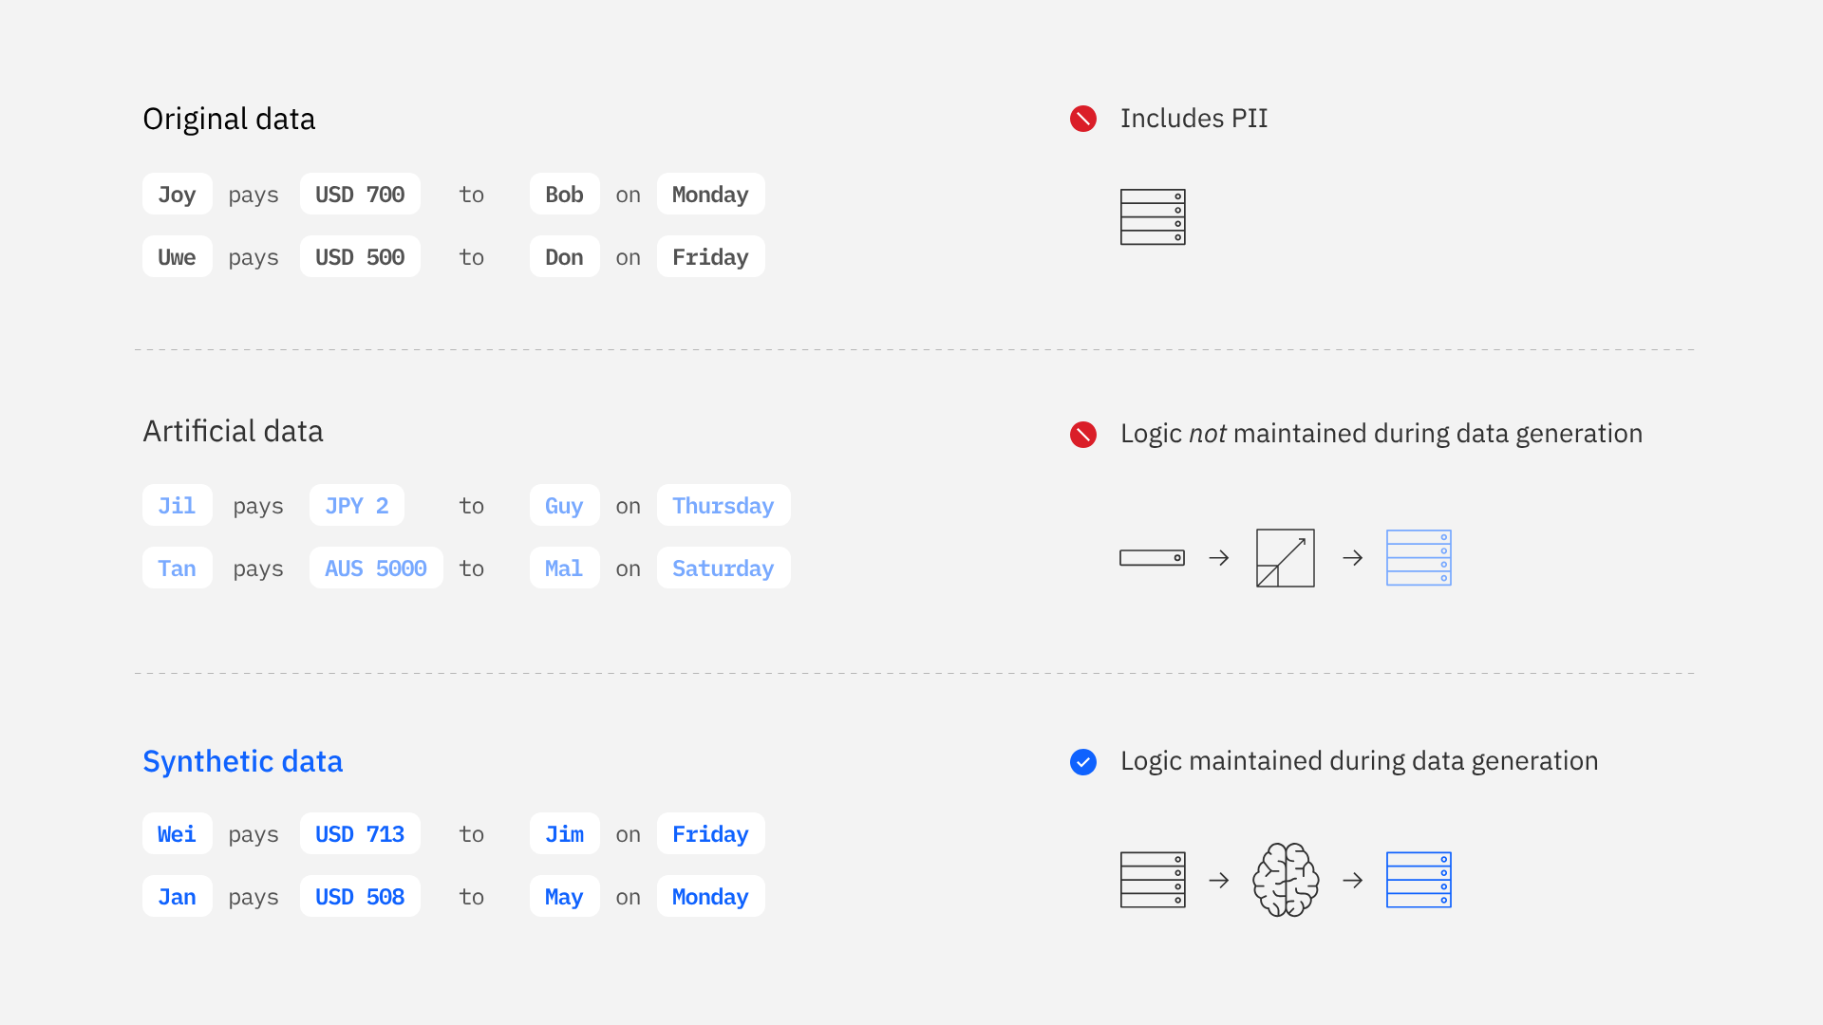
Data Description
Dataset: IBM Synthetic data for core banking and money laundering.
The dataset includes simulated banking transactions labeled for money laundering, check fraud and automated push payment (APP) fraud.
Include the labelled transaction for laundering, check fraud, and legitimate activity.
Provide an ethical, realistic alternative to restricted real-world data.
Realistic synthetic data
source: IBM synthetic-data-sets

Slide 4
Proposed Methodology
Approach: Supervised Learning for classification. (Laundering vs Not Laundering)
Algorithms: Ensemble learning
(Random Forest, Gradient Boosting, Adaboost, and more).
Data pipeline:
Ingestion → Preprocessing→ Modeling→ Evaluation→ Deployment.
Deployment: Streamlit app with alerting risk integration.
Notes:
The CRoss Industry Standard Process for Data Mining (CRISP-DM) is a process model with six phases that describes the data science life cycle.
1. Business Understanding
Define the project's objectives from a business perspective and determine the success criteria.
2. Data Understanding
Collect and explore the initial data, describe it, and verify its quality.
3. Data Preparation
Select, clean, construct, integrate, and format the data to be suitable for modeling.
4. Modeling Select
appropriate modeling techniques, generate a test design, and build the actual model(s).
5. Evaluation
Evaluate the models against the business objectives, review the overall process, and decide on the next steps.
6. Deployment
Plan the deployment of the model, set up monitoring and maintenance, and communicate the final report to stakeholders.

Slide 5
First Ideas (Expected to Evolve)
Simulate batch transaction streams to mimic real-time monitoring.
Build compliance-focused dashboard for compliance teams
Consider ensemble or multi model approaches for robustness and better accuracy.
Implements alerts notifications, that are flagged as risk.

Slide 6
Intended Results and Benefits
Project Benefit
Reduced Financial Losses and Increased Operational Efficiency.
The company saves money by catching more fraud. The compliance team saves time and resources by investigating fewer false alerts.
2. Enhanced Transparency & Strengthened Trust
The dashboard provides a clear, real-time view of risk, which builds confidence with partners and regulators.
Empowered, Data-Driven Decision-Making and Proactive Security
Instead of just getting an alert, the team understands why it was flagged.
This leads to faster, more accurate investigations and helps identify new threat patterns before they cause significant damage.
Intended Result
Deliver a functional fraud detection dashboard.
Improve detection accuracy and efficiency over rule-based methods.
Provide actionable insights for the compliance team.

Slide 7
Outputs & Real-World Use
Outputs
A Trained Machine Learning Model:
A model that validated to outperform legacy rule-based methods in both accuracy and efficiency.
A Functional Fraud Monitoring Dashboard:
A centralized, visual interface that displays key risk indicators, model alerts, and transaction data in real-time.
Real world Use
Automated & Precise Threat Detection:
The model is used to automatically scan transactions in real-time, stopping sophisticated fraud attempts instantly while reducing the number of legitimate customers who are incorrectly flagged.
Centralized Risk Command Center:
The compliance team uses the dashboard daily to monitor the platform's health, prioritize the most critical alerts, and provide transparent, data-driven reports to regulators and partners.

Slide 8
Thank You

Slide 9
The connection between FinTech failure and a lack of transparency in fraud monitoring is all about trust.
BaaS platforms don't operate in a vacuum, they depend on partner banks (who hold the actual banking licenses) and regulators for their existence.
If a FinTech has an approach to risk monitoring, partners and regulators have no visibility into how effectively the platform is protecting the financial system from bad actors.
When a major fraud incident occurs (and it will), a lack of transparency creates a crisis of confidence. The partner bank and regulators will ask:
Why wasn't this caught?
What is your process for detecting this?
How can we be sure it won't happen again?
If the FinTech can't provide clear, data-backed answers, partners may completely and permanently end a relationship and regulators may impose fines or even revoke the ability to operate.
This loss of trust is a direct path to business failure.
Answers for the feedback on the last presentation

